Slide 1
Drugs, Toxins& the liver
Prof Anuradha Dassanayake
Department of Pharmacology
Faculty of Medicine
University of Kelaniya

Slide 2
Objectives
To learn about the drugs and toxins affecting the liver
Paracetamol poisoning
Prescribing in patients with liver disease

Slide 3
Drugs & toxins affecting the liver
Alcohol
Paracetamol
Rifampicin/INAH/Pyrazinamide
Statins
Chlorprmazine
Halothane
Herbal Medicines/Alternative medicines

Slide 4
Mechanisms of liver injury
Type A Dose dependant
  Paracetamol
Type B Occurs with Normal Doses
  NSAID’S,Halothane,Chlorpromazine
  Immunological
Type C with cont-use
  Anabolic steroids
  Methotrexate

Slide 5
Types of liver injury
Necrosis
  Paracetamol
  paraquat
Steatosis
  Tamoxifen
Cholestasis
  Chlorpromazine
Adenoma
  OCP
Fibrosis
  Methotrexate

Slide 6
Management of drug induced liver disease
Use drugs with caution in patients with existing liver disease
Take a good drug history including herbal medicines
Exclude other possible causes of hepatitis like alcohol and viruses
Stop the offending drug
No specific treatment

Slide 7
Paracetamol poisoning
NABQI a minor metabolite of Paracetamol metabolosm is toxic to the cells
This substance is normally made harmless by gutathione
Liver glutathione supply is limited
Severe liver toxicity can occur with a dose of 150mg/kg(10-20 tab)

Slide 8
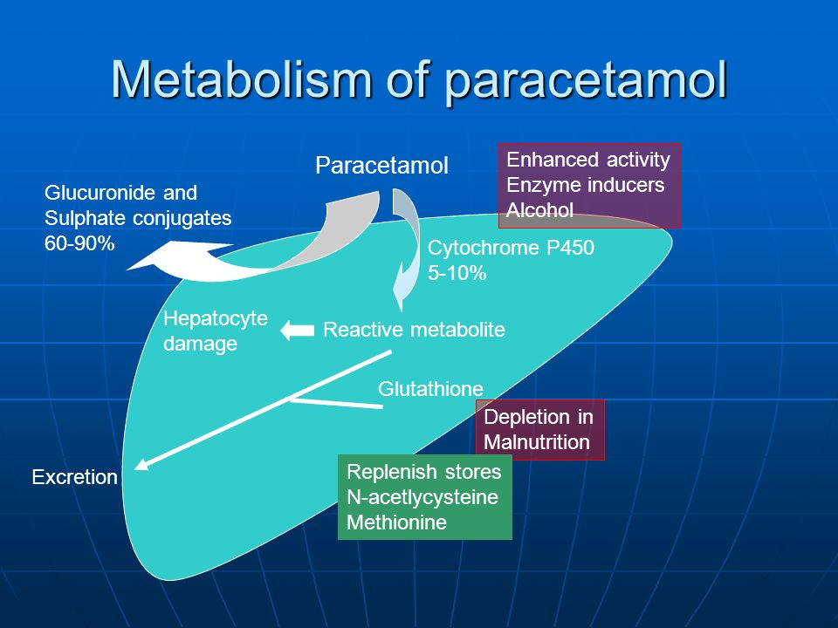

Slide 9
Paracetamol poisoning cont-
Toxicity occurs at a lower dose in
  Alcohol abuse
  Malnutrition
  Fasting
  In patients with cardiopulmonary and liver disease
  On other drugs
    Phenytoin

Slide 10
PCM poisoning MX
Gastric lavage should be performed if presents within 4 hours
Serum paracetamol level at 4 hours is a predictor of liver toxicity
After the first 24-48 hours protrombin time of >100 is a poor prognostic factor

Slide 11
PCM toxicity Mx Cont-
N Acetyl Cystein (NAC)is the antidote of choice
If given within first 16 hours significant hepatotoxicity is rare
Usually given as an intravenous infusion
Methionine orally is also used

Slide 12
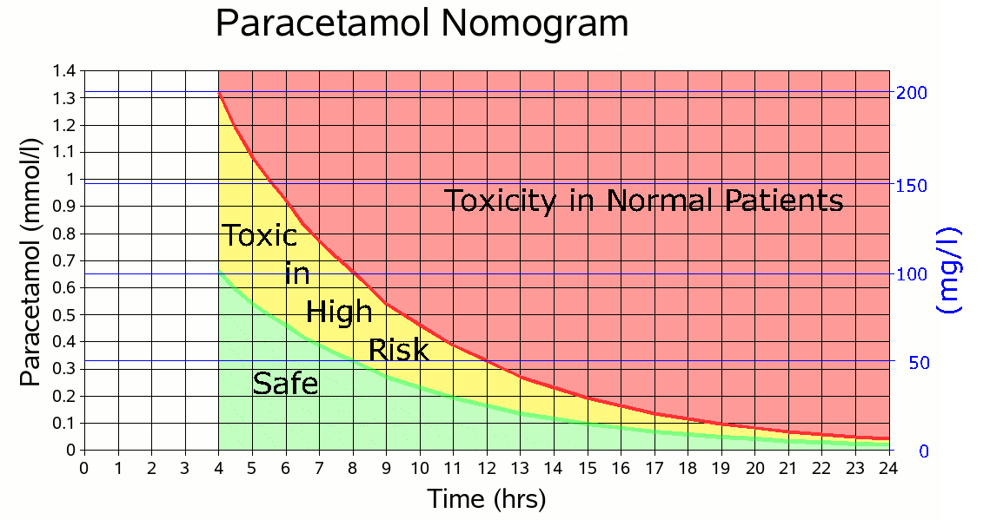

Slide 13
Prescribing in liver disease
Liver is the main site of drug detoxification & elimination
In liver disease ideally we should use drugs with wide therapeutic index , which are excreted by the kidney.
Unfortunately we have to use drugs which are not excreted by the kindey but with dose modifications.

Slide 14
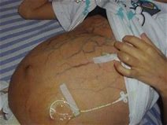
Degree of liver impairment
Child’s grade important
  Childs A
  Childs B
  Childs C
MELD score

Slide 15
Potentially harmful drugs
Sedatives eg - Diazepam precipitates HE.
  May cause respiratory depression at a lower dose
Diuretics- Can lead to dehydration , Electrolyte imbalance & HE
NSAIDS - Salt and water retention, worsen ascites & swelling ,exaggerated effects on GI bleeding
Nephrotoxic drugs eg Aminoglycosides may worsen kidney function.

Slide 16
Potentially harmful drugs
Phenytoin & Theophylline toxicity due to reduced drug clearance
Anticoagulants may precipitate bleeding
  Eg –Warfarin,Aspirin

Slide 17
Statins in liver disease
Statins are useful in certain situations.
Should be use if indicated in patients with well compensated cirrhosis

Slide 18
Pain relief in liver disease
NSAIDs are contraindicated
Paracetamol in reduced doses safe
Narcotics are useful but can precipitate HE
  Causes constipation
  Nausea
Pain modulators – Pregabalin
Local therapies – Good alternative

Slide 19
Sedatives in liver disease
All sedatives should be used with caution
Benzodiazepines are contraindicated
Zolpidem/ Melatonin/ Antihistamines are useful

Slide 20
SDL
Acute liver failure
Chronic liver failure

